Slide 1
Development workflows and Git
Various
ICT40120 Certificate IV in Information Technology
Applied Programming in Python
ICTICT449 | Use version control systems in development environments
ICTPRG430 | Introductory object-oriented techniques

Slide 2
Session Contents
The big picture: what does software development look like?
How this impacts usage of Git
Workflow we’ll employ at TAFE

Slide 3
Development workflows
Software development is a creative activity
“Research and development”
Failure is part of life
Risk in software includes:
Opportunity costs
Loss of investment
Business disruption

Slide 4
Two fundamental ways to manage risk
Reduce the probability of failure
Reduce the cost of failure
risk = likelihood × cost

Slide 5
Reducing the likelihood of failure
Do a lot of planning
Research the problem extensively
Ensure there is already a market
Hire developers with a lot of specific experience in the domain you want to enter
But that is also a risk…

Slide 6
The risks of reducing risks
Consider:
if you did that, would you be early or late to market?
Would being late to market increase or decrease the likelihood of failure?
Would reducing risk increase cost?
Paradox:
The act of reducing risk can increase risk in certain market conditions (which are common in software development)

Slide 7
Modern software development
Modern software development tends to focus on reducing the cost of failure rather than probability of failure
Recognition of the paradox: minimizing risk in a fast-moving market with short windows of opportunity can increase risk
“Fail fast. Fail early”

Slide 8
Approaches to development
Waterfall: clear stages of development – analysis, design, implementation , testing, deployment, maintenance.
Agile: iterative, fluid transition between all stages of development.
Agile and agile-inspired methodologies are more popular today in most software companies.

Slide 9
Analysis
Familiarize with the problem
Design
Identify a solution
implementation
Write the code
Testing
Deployment
Maintenance
Confirm that it works
Release the software
Fix bugs and update
Waterfall

Slide 10
Version control in a waterfall-like world
Development
Test
Production
repos or permanent branches

Slide 11
Develop
Test
Release
Adapt
Agile
Frequent releases
Automation
Responding to change > following a plan

Slide 12
Version control in a more agile world
main/trunk
Feat
Bug
ephemeral branches: proximity to trunk

Slide 13
Consequences of agile
Cultural: Emphasis on reviews/collaboration/individual responsibility
Technical: Increased automation
Unit testing
Integration testing
Static analysis
Deployment
Compiling
Publishing
Documentation

Slide 14
Documentation
Documentation as code
Instead of a discrete practice also part of code
Relies on standardization and tooling
Emergent rather than bespoke

Slide 15
VCS is key to agile
Automation
Hooks
Failure tolerance
PRs
Communication
Collaboration

Slide 16
Key takeaways at our level
Understand the requirements of a given project in terms of:
When to branch
Who can merge a branch
Requirement for merging
Follow standards for commit messages

Slide 17
GitHub Flow
Feature branching
Pull request
Merge and delete branch
Approvals and automation through GitHub actions
More on that next week and next semester

Slide 18
Commit message standards
https://udacity.github.io/git-styleguide/#:~:text=Subjects%20should%20be%20no%20greater,change%3B%20not%20changed%20or%20changes.
https://www.conventionalcommits.org/en/v1.0.0/#summary

Slide 19
Releases, tags, and semantic versioning

Slide 20
Releases
A release is a snapshot of the project from a point in time packaged for end users
Includes compiled binaries (if applicable), source code, documentation, and release notes
Release notes: summarize changes between releases

Slide 21
Lightweight Tags
A reference to a commit (like a branch!)
Unlike a branch ALWAYS points to the same commit
Identifies important points in the project (what? A342B1C2 not good enough for you) – typically used as a bookmark
git tag 0.1
Notes:
See https://git-scm.com/book/en/v2/Git-Basics-Tagging

Slide 22
Annotated Tags
A reference to a commit that contains meta data and stored inside git (a bit like a commit-commit)
ALWAYS points to the same commit
Identifies important milestones in the project (what? A342B1C2 not good enough for you) – typically used to identify releases
git tag –a v1.0.0 –m “Important version”
Notes:
git tag v1.0.0
git push origin v1.0.0

Slide 23
Semantic Versioning (SemVer)
Structured (and well understood) way of labelling software versions for end users:
MAJOR.MINOR.PATCH.
MAJOR: Changes that break compatibility. 1.0.0 → initial stable release
MINOR: New features that don't break compatibility. 1.1.0 → added a new feature (still compatible)
PATCH: Bug fixes and minor improvements. 1.1.1 → bug fix, no new features
Notes:
https://semver.org/

Slide 24
Code documentation
Documentation is often embedded in the code
All major programming languages have tools and frameworks to generate documentation
Understand the difference between
Comments
In code documentation

Slide 25
What you need to know (now)
Developer documentation
Use commenting techniques. Capture your algorithm. Use test cases to support other developers.

Slide 26
module docstring
"""Provides a set of functions for implementing a command line Wordle clone"""
# AUTHOR: Rafael
# DATE: March 2022
# Implements a naive scoring algorithm for Wordle
# TODO: Implement a more sophisticated scoring algorithm
def score_guess(guess, target):
"""
Determines the score (clues) for each character in a guess for a given target word.
Parameters
----------
guess : a string representing a guess of the target word
target : a string representing the target word
Returns
-------
score : tuple
A tuple with the score for each character in the guess.
0: MISS, 1: MISMATCH, 2: EXACT.
Examples
---------
>>> score_guess('cat', 'cat')
(2, 2, 2)
>>> score_guess('hat', 'cat')
(0, 2, 2)
"""
guess_work = list(guess) # convert to list for easier manipulation
...
comments
function docstring

Slide 27
"""Provides a set of functions for implementing a command line Wordle clone"""
# AUTHOR: Rafael
# DATE: March 2022
# Implements a naive scoring algorithm for Wordle
# TODO: Implement a more sophisticated scoring algorithm
def score_guess(guess, target):
"""
Determines the score (clues) for each character in a guess for a given target word.
Parameters
----------
guess : a string representing a guess of the target word
target : a string representing the target word
Returns
-------
score : tuple
A tuple with the score for each character in the guess.
0: MISS, 1: MISMATCH, 2: EXACT.
Examples
---------
>>> score_guess('cat', 'cat')
(2, 2, 2)
>>> score_guess('hat', 'cat')
(0, 2, 2)
"""
guess_work = list(guess) # convert to list for easier manipulation
...
function docstring
Focuses on how a developer uses the function:
Parameters,
Returns,
Examples,
Exceptions
Exposed by IDE and Python’s help() built-in
Often extracted by other processes for reference information
comments

Slide 28
"""Provides a set of functions for implementing a command line Wordle clone"""
# AUTHOR: Rafael
# DATE: March 2022
# Implements a naive scoring algorithm for Wordle
# TODO: Implement a more sophisticated scoring algorithm
def score_guess(guess, target):
"""
Determines the score (clues) for each character in a guess for a given target word.
Parameters
----------
guess : a string representing a guess of the target word
target : a string representing the target word
Returns
-------
score : tuple
A tuple with the score for each character in the guess.
0: MISS, 1: MISMATCH, 2: EXACT.
Examples
---------
>>> score_guess('cat', 'cat')
(2, 2, 2)
>>> score_guess('hat', 'cat')
(0, 2, 2)
"""
guess_work = list(guess) # convert to list for easier manipulation
...
# comments
Minimal, a last resort. Consider:
Naming of functions and variables, structure of code, before adding a comment!
function docstring
Focuses on how a developer uses the function:
Parameters,
Returns,
Examples,
Exceptions
Not extracted or exposed unless someone is actively reading your source code.
Can be on the same line as code or on its own line.
Exposed by IDE and Python’s help() built-in
Often extracted by other processes for reference information

Slide 29
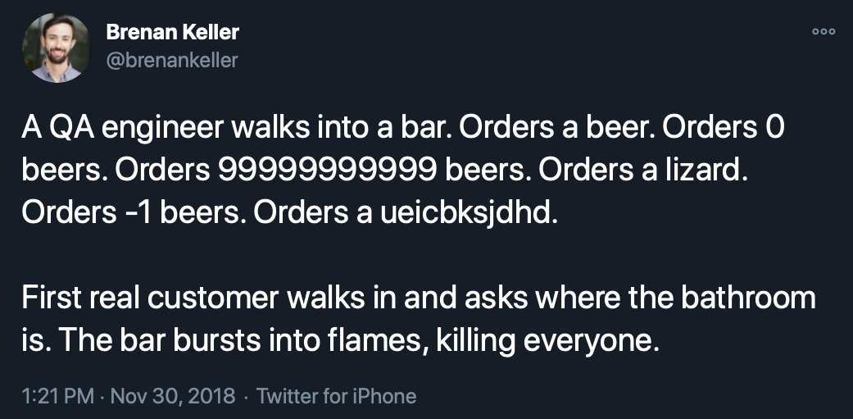
Test Cases
Project Documentation

Slide 30

Testing
Integral for quality and ensuring solution meets requirements
Testing is a formal part of development process
Shared by team
Developers test their own code
A dedicated test team may also be involved

Slide 31
Test case
A set of steps
An expected outcome
Considers a variety of possible inputs

Slide 32
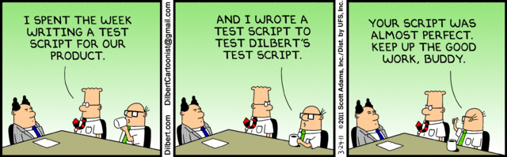
Automated or manual
A written document that describes the planned steps (manual)
Or documented code that performs the tests (automated)

Slide 33
Unit vs. Functional
Unit: a test of an individual function or part of code. Usually done informally and through automation by the developer. Generally, it is also automated
Functional: a test of an action that can be performed by a user (usually involving multiple functions). Typically, done by a tester, automation not always used (but increasingly so)

Slide 34
doctests: Documentation + Tests
Action
Expected outcome
Unit or functional?
Automated or manual?
Write a functional test you could perform that isn’t currently in the doctests
Examples
---------
>>> score_guesses('cat', 'cat')
(2, 2, 2)
>>> score_guesses('hat', 'cat')
(0, 2, 2)
import doctest
doctest.testmod()

Slide 35
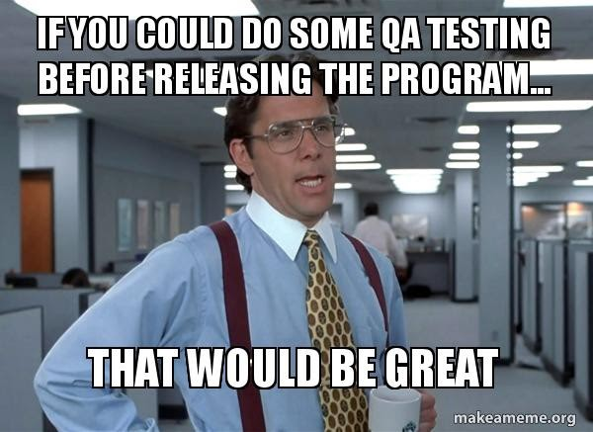

Slide 36
Summary
Development is closer to trunk
VCS is more important than ever
Trigger for automated tests and documentation generation
Commit messages and branching rules need to be standardized to facilitate communication and automation

